Slide 1

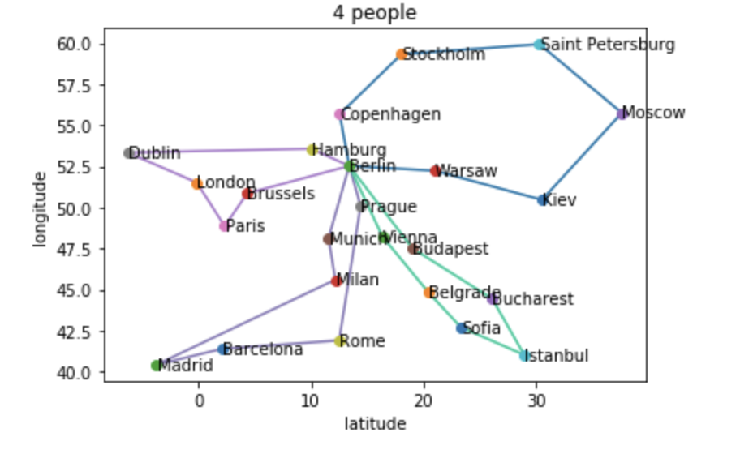

Vehicle Routing Problem
Govardhini Bandla, Norberto Limon, Faria Haque, Minh Vong, Kanwarpreet Singh
Introduction
The test-vrp-agent() function tests the learned policy on a new set of VRP instances.
The Q-learning update rule is as followed:
Q(s, a) ← Q(s, a) + α(r + γ max_a' Q(s', a') - Q(s, a))
Q(s, a) represents the Q-value of state-action pair (s, a)
α is the learning rate
r is the reward obtained by taking action a in state s
γ is the discount factor
max_a' Q(s', a') is the maximum Q-value over all possible actions a' in the next state s'
Epsilon-greedy exploration:
if random.uniform(0, 1) < ε:
a ← random action
else:
a ← argmax_a' Q(s, a')
ε is the probability of taking a random action (exploration)
argmax_a' Q(s, a') is the action that maximizes the Q-value in state s
Future work
The VRP is an integer programming and combinatorial optimization problem that involves determining the best routes for a fleet of vehicles to take in order to efficiently deliver goods to a specific group of customers. Essentially, the VRP expands upon the well-known TSP.
The model was successfully trained. However, more work will be focus on the testing phase of the code.
References
Asghari, M., & Mirzapour Al-e-hashem, S. M. J. (2021). Green vehicle routing problem: A state-of-the-art review. International Journal of Production Economics, 231, 107899. https://doi.org/10.1016/j.ijpe.2020.107899
Abdirad, Krishnan, Gupta; “A Two-Stage Metaheuristic Algorithm for the Dynamic Vehicle Routing Problem in Industry 4.0 approach”,form
https://arxiv.org/ftp/arxiv/papers/2008/2008.04355.pdf
Rishi Wadhwa GB. (2022, March 17) The Evolution of India's data privacy regime in 2021. The evolution of India's data privacy regime in 2021. https://iapp.org/news/a/the-evolution-of-indias-data-privacy-regime-in-2021/.
Abstract
Due to the nature of the traditional combinatorial algorithms applications, the methodologies of Reinforcement Learning (RL) to NP-Hard Combinatorial optimization problems has become a popular topic. Our project focuses on the application of Reinforcement Learning for the Vehicle Routing Problem (VRP) which is a famous combinatorial problem.
Methodologies
Results
Reinforcement Learning for VRP with
Q-learning model. The model implements a Q-learning algorithm for solving VRP that defines a VRP environment class that simulates VRP environment and conduct the step() function, which takes action (ie., choosing a customer to visit) for each vehicle and returns the next state, the reward, and whether the episode is done.
The train-vrp-agent() function uses the Q-learning algorithm to learn the optimal policy for the VRP. It initializes a Q-table and trains the agent for a specified number of episodes. The code uses an epsilon-greedy exploration strategy to balance between exploration and exploitation.
From testing the VRP agent, we were able to successfully initialize and extract Q-table with a shape that can hold all possible states and actions as well as their results of each episode.
The problem was also solved using Google OR tools to determine the optimal routes for all participating vehicles.

Slide 2
